Slide 1
Machine Learning
Dr. Monali Mavani

Slide 2

Machine Learning
Disclaimer and Acknowledgement
The content for these slides has been obtained from books and various other source on the Internet
I here by acknowledge all the contributors for their material and inputs.
I have provided source information wherever necessary
I have added and modified the content flow to suit the requirements of the course and for ease of class presentation
Students are requested to refer to the textbook and detailed content of this presentation deck over canvas

Slide 3
Course Introduction
Objective of course
Introduction to the basic concepts and techniques of Machine Learning
Gain experience in basics of doing independent study and research in the field of Machine Learning
Develop skills of using recent machine learning software tools to evaluate learning algorithms and model selection for solving practical problems
Focus of this course
Strong Mathematical Foundations of ML algorithms
Structured Data Analytics
IDD (Independent & Identically Distributed Data)
Topics not expected of this course
Unstructured Data Analytics
Time Series/Sequence Data Analytics
Deep Learning

Slide 4
Course Plan
M1 | Introduction
M2 | Machine learning Workflow
M3 | Linear Models for Regression
M4 | Linear Models for Classification
M5 | Decision Tree
M6 | Instance Based Learning
M7 | Support Vector Machine
M8 | Bayesian Learning
M9 | Ensemble Learning
M10 | Unsupervised Learning
M11 | Machine Learning Model Evaluation/Comparison

Slide 5
Pre-requisites
Linear algebra: vector/matrix manipulations, properties
Calculus: partial derivatives
Probability: common distributions; Bayes Rule
Statistics: mean/median/mode; maximum likelihood

Slide 6
Text books and Reference book(s)
T1 | Tom M. Mitchell: Machine Learning, The McGraw-Hill Companies
R1 R2 R3 | Christopher M. Bishop: Pattern Recognition & Machine Learning, Springer P. Tan, et al. Introduction to Data Mining, Pearson C.J.C. BURGES: A Tutorial on Support Vector Machines for Pattern Recognition, Kluwer Academic Publishers, Boston. Evaluation scheme Quiz (10% - Best 2 of 3 quizzes) Assignment (20% - 1 Progressive) Mid-semester exam (30%) Comprehensive exam (40%)

Slide 7
Lab Plan
Lab No. | Lab Objective
1 | End to End Machine Learning
2 | Linear Regression and Gradient Descent Algorithm
3 | Logistic Regression Classifier
4 | Decision Tree
5 | Naïve Bayes Classifier
6 | Random Forest
Labs not graded
Most of the Lab recordings available at CSIS virtual labs
Webinars will be conducted for lab sessions
Labs will be conducted in Python

Slide 8
Agenda
What is Machine Learning?
Why Machine Learning is important?
Types of Machine Learning
ML workflow
Few Terminologies
Data types
Demo

Slide 9
What is Machine Learning

Slide 10
How can we solve a specific problem?
we write a program that encodes a set of rules that are useful to solve the problem
Write a program : given a picture determine whether there is a cat in the image
Learning systems are not directly programmed to solve a problem, instead develop own program based on:
Examples of how they should behave
Learning simply means incorporating information from the training examples into the system

Slide 11
What is Machine Learning?
The science (and art) of programming computers so they can learn from data
More general definition
Field of study that gives computers the ability to learn without being explicitly programmed
Engineering-oriented definition
Algorithms that improve their performance P at some task T with experience E
A well-defined learning task is given by <P, T, E>

Slide 12
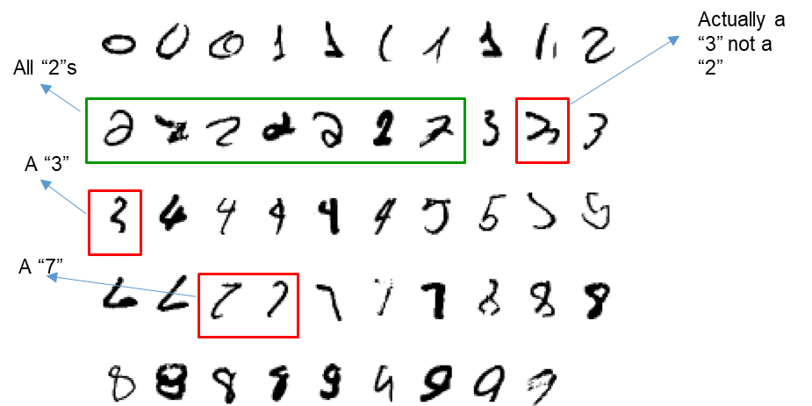
Defining the Learning Tasks
Improve on task T, with respect to performance metric P, based on experience E
Example 1
T: Recognizing hand-written words
P: Percentage of words correctly classified
E: Database of human labelled images of handwritten words
Example 2
T: Categorize email messages as spam or legitimate.
P: Percentage of email messages correctly classified.
E: Database of emails, some with human-given labels

Slide 13
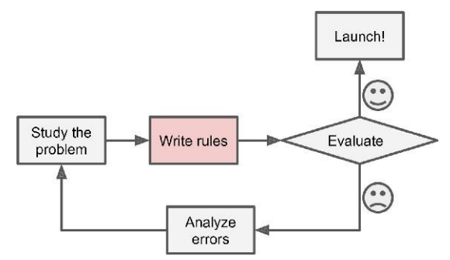
Traditional Approach - Spam Filtering
Spam typically uses words or phrases such as “4U,” “credit card,” “free,” and “amazing”
Solution
Write a detection algorithm for frequently appearing patterns in spams
Test and update the detection rules until it is good enough.
Challenge
Detection algorithm likely
to be a long list of complex rules
hard to maintain.

Slide 14
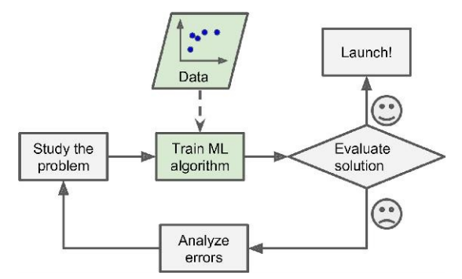
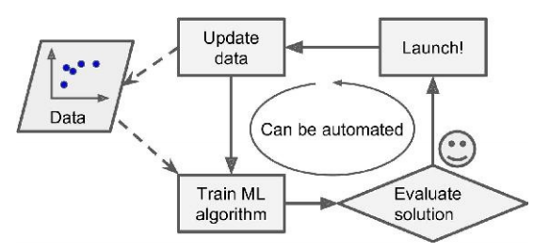
ML Approach - Spam Filtering
Automatically learns phrases that are good predictors of spam by detecting unusually frequent patterns of words in spams compared to “ham”
The program is much shorter, easier to maintain, and most likely more accurate.

Slide 15
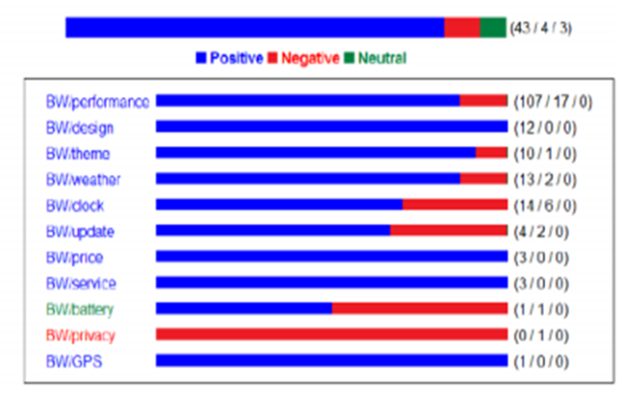
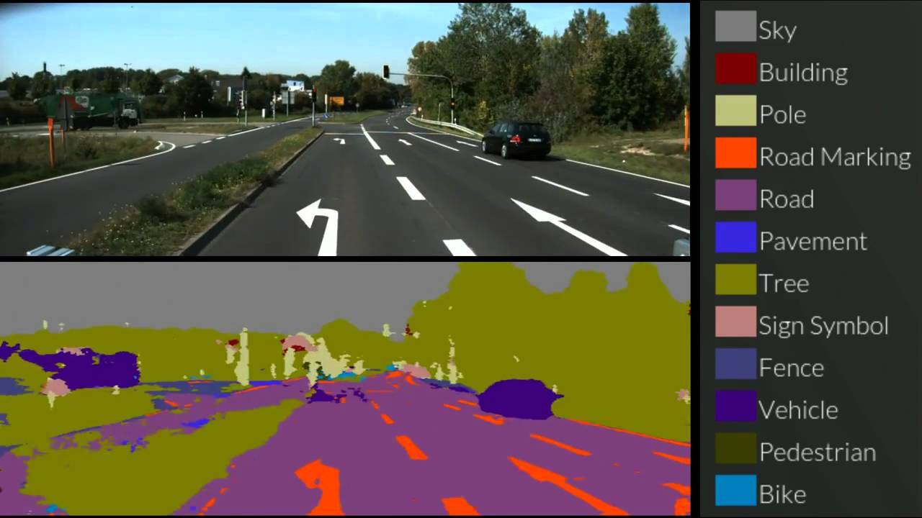
Common Use cases - Security & Transaction Domain
Self Driving Cars
Fraud Detection in Banking
Email Filtering
Dynamic Pricing in Travel
Derived Applications:
> Cyber Security
> Video Surveillance
> Object Detection
Sentiment analysis on Product review of Mobile phone

Slide 16

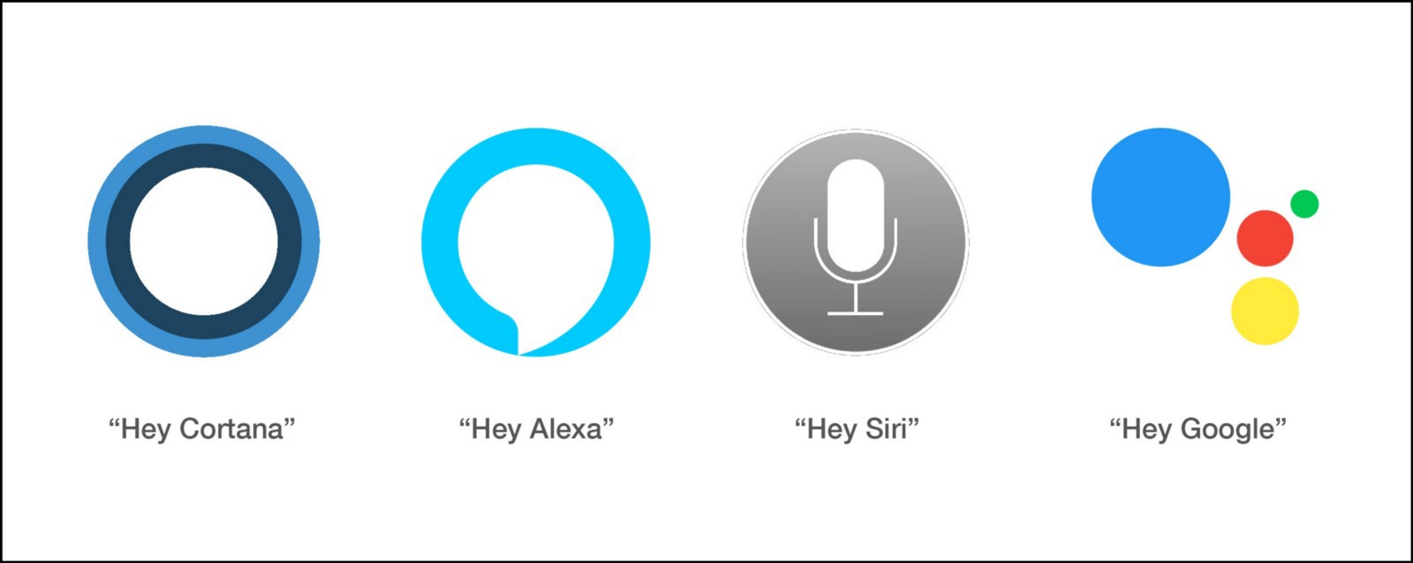
Common Use cases - Customer Support Systems
Apple’s Siri
Google Assistant
Amazon’s Alexa
Google Duplex
Microsoft’s Cortana
Samsung’s Bixby
Derived Applications:
> Customer Support Query (Voice vs Text)
> Chatbots

Slide 17

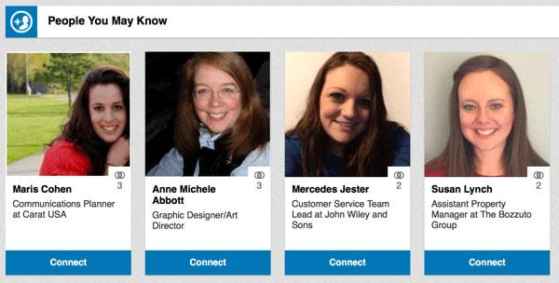

Common Use cases - Recommendation Engines
E-commerce sites like Amazon and Flipkart
Book sites like Goodreads
Movie services like IMDb and Netflix
Hospitality sites like MakeMyTrip, Booking.com, etc.
Retail services like StitchFix
Food aggregators like Zomato and Uber Eats
Derived Applications:
> Personalized Marketing
> Personalized Banking

Slide 18
Why ML

Slide 19
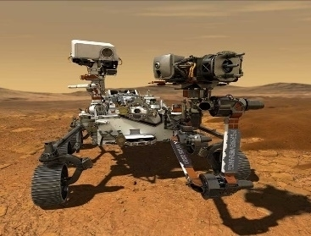

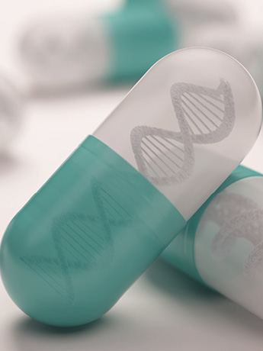

When Do We Use Machine Learning?
ML is used when:
Human expertise does not exist (navigating on Mars)
Humans can’t explain their expertise (Biometrics)
Models must be customized (personalized medicine)

Slide 20
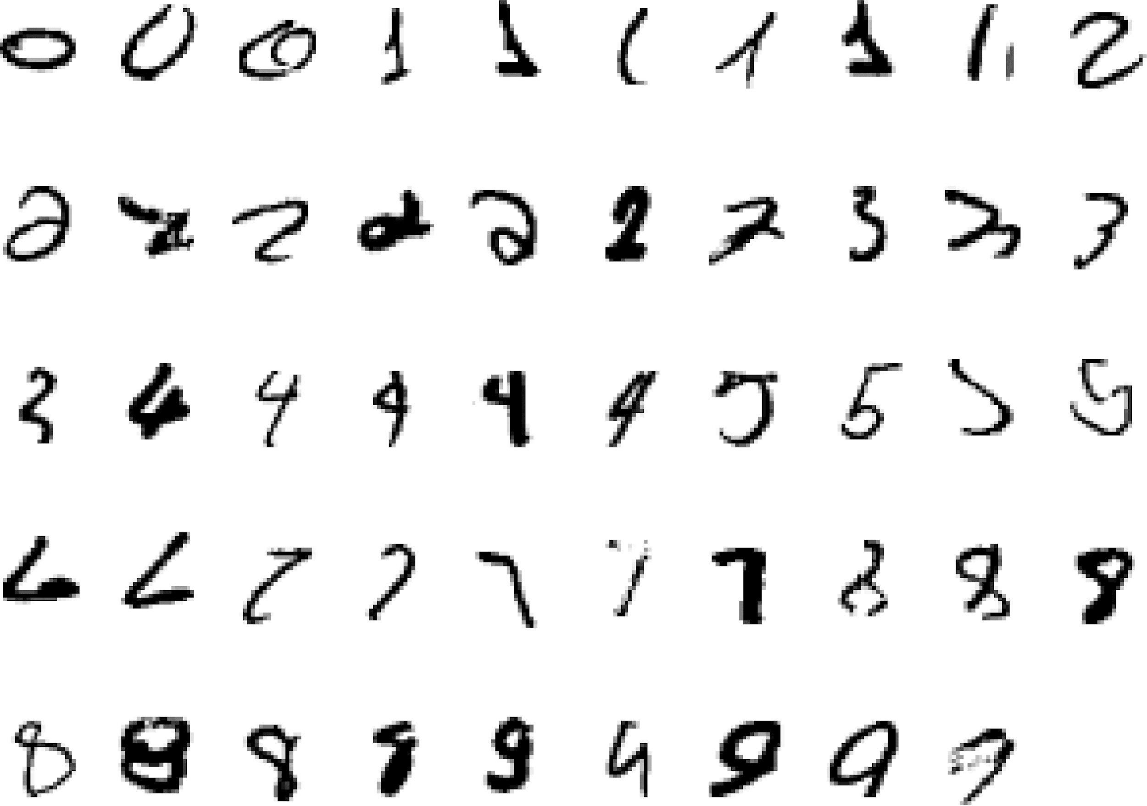
Why only ML?
Some tasks cannot be defined well, except by examples.
It is very hard to write programs that solve problems like recognizing a handwritten digit
What distinguishes a 2 from a 7?
How does our brain do it
Hidden relationships and correlations in data
large data makes it difficult for explicit encoding by humans (e.g., medical diagnostic)
Continuous availability of new knowledge
Pattern recognition

Slide 21
Problems not to be solved using ML
Learning isn’t always useful:
Tasks in which humans are very effective
Tasks in which frequent human intervention is needed
Simple tasks which can be implemented using traditional programming paradigms
Situations where training data is not sufficient

Slide 22
Types of ML

Slide 23
Types of Learning Inputs: Based on level of supervision
Supervised (inductive) learning Given: training data, desired outputs (labels)
Unsupervised learning
Given: training data (without desired outputs)
Semi-supervised learning
Given: training data + a few desired outputs
Reinforcement learning
Given: rewards/penalty from sequence of actions
Slide Credit: Eric Eaton

Slide 24
Supervised (inductive) learning

Slide 25
Supervised Learning Techniques / Algorithms
Linear Regression
Logistic Regression
Naïve Bayes Classifiers
Support Vector Machines (SVMs)
Decision Trees and Random Forests
Neural networks

Slide 26
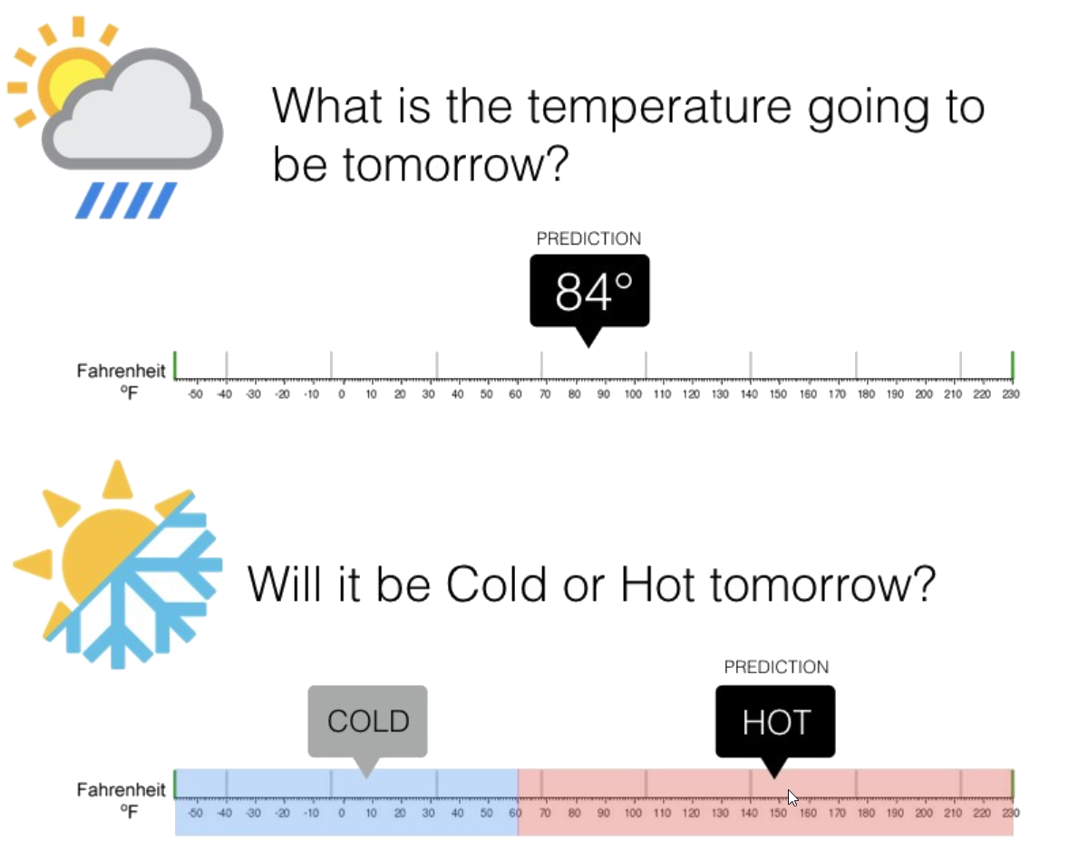
Supervised Learning – Regression & Classification

Slide 27

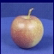
Classification
Training
Training Labels
Training Images
Features
Training
Learned model
Testing
Features
Learned model
Prediction
Test Image
Slide credit: D. Hoiem and L. Lazebnik

Slide 28
Classification - Examples
Objective: Employability Prediction
Features / Attributes / Predictors
CGPA
Communication Skills
Aptitude
Programming Skills
S.No. | CGPA | Communication Skills | Aptitude | Programming Skills | Job Offered?
1 | 9.1 | Average | Good | Excellent | Yes
2 | 8.4 | Good | Good | Good | Yes
3 | 8.3 | Poor | Average | Average | No
4 | 7.1 | Average | Good | Average | No
5 | 8.2 | Good | Excellent | Excellent | No

Slide 29
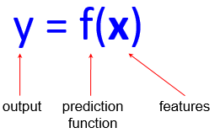


















Classification
Given (x^{[1]}, y^{[1]}), (x^{[2]}, y^{[2]}), ..., (x^{[n]}, y^{[n]})
Learn a function f (x) to predict y given x
– y is categorical
Learnt classifier
If x>T, malignant else benign
Cancer (benign / malignant)
y=1 (malignant)
y=0 (benign)
Tumor Size (x)

Slide 30










Classification
x can be multi-dimensional
– Each dimension corresponds to an attribute
Increasing Feature Dimension
Age
Tumor Size

Slide 31

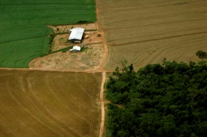
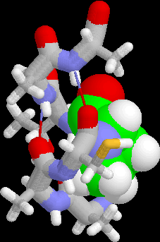
Examples of Classification Task
Fraud Detection
Direct Marketing
Churn prediction for telephone customers
Email Spam detection
Classifying land covers (water bodies, urban areas, forests, etc.) using satellite data
Categorizing news stories as finance, weather, entertainment, sports, etc.
Predicting tumour cells as benign or malignant

Slide 32
Regression- Example
Objective : Predicting price of a used car
Features / Attributes / Predictors
Brand
Year (Mfg)
Engine Capacity
Mileage
Distance travelled
Cab?
S.No | Brand | Year (Mfg) | Engine Capacity | Mileage | Distance travelled | Cab? | Price (in Rs.)
1. | Honda City ZX | 2008 | 1100 | 10.5 | 45000 | N | 3,50,000
2
3
4

Slide 33
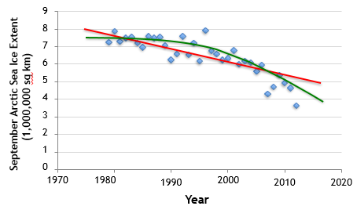
Regression
Given (x^{[1]}, y^{[1]}), (x^{[2]}, y^{[2]}), ..., (x^{[n]}, y^{[n]})
Learn a function f(x) to predict y given x

Slide 34
Examples of Regression Task
Predicting house prices
Forecasting sales figures
Estimating patient recovery times
Predicting tomorrow’s weather

Slide 35
Unsupervised learning

Slide 36
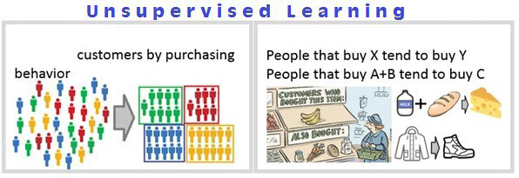
Unsupervised Learning – Clustering & Association

Slide 37
Clustering- Examples
Objective: Market Segmentation Study
Customers for a retailer may fall into
two groups say big spenders and
low spenders
three groups say big spenders,
medium spenders and low spenders
Four groups, ….
Features / Attributes / Predictors
Family income
# of visits in a month
Average money spent in a month
Zip code
S.No. | Zip Code | Family Income | # of visits in a month | Average Money Spent in a month
1 | 500078 | 11,50,000 | 4 | 8,000

Slide 38















Unsupervised Learning
GOAL : Intra cluster distances are minimized and inter cluster distances are maximized
Given x^{[1]}, x^{[2]}, ..., x^{[n]} (without labels)
Output hidden structure behind the x’s
e.g., clustering
Slide Credit: Eric Eaton

Slide 39
Unsupervised Learning
Applications
Personalized recommendation system
Targeted marketing
Spam Filters
Content Management – News hosted in Web
Campaigning
Techniques
Clustering
k-Means
Hierarchical Cluster Analysis
Expectation Maximization
Visualization and dimensionality reduction
Principal Component Analysis (PCA)
Kernel PCA
Locally-Linear Embedding (LLE)
t-distributed Stochastic Neighbor Embedding (t-SNE)

Slide 40
Semi supervised Learning

Slide 41
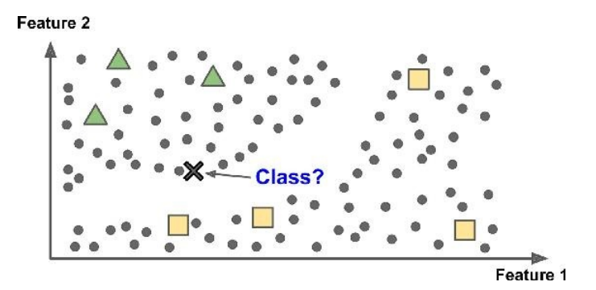
Semi supervised Learning
Partially labelled data – some labelled data and a lot of unlabelled data
Combines unsupervised and supervised learning algorithms
Photo hosting service, e.g., google photos

Slide 42
Reinforcement Learning

Slide 43
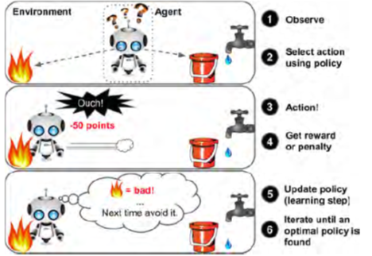
Reinforcement Learning

Slide 44
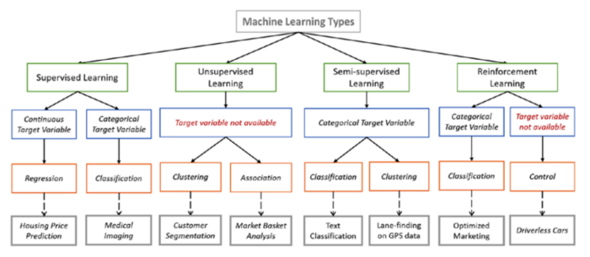
Types of Learning
Image courtesy: https://towardsdatascience.com/types-of-machine-learning-algorithms-you-should-know-953a08248861

Slide 45
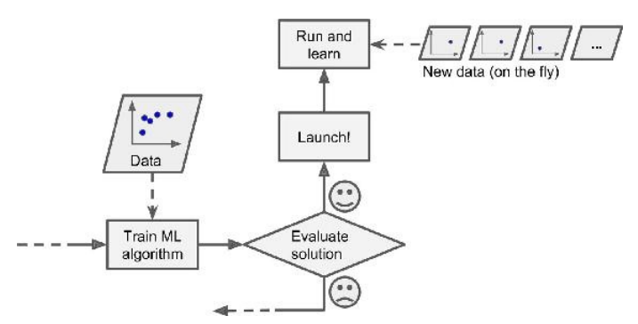
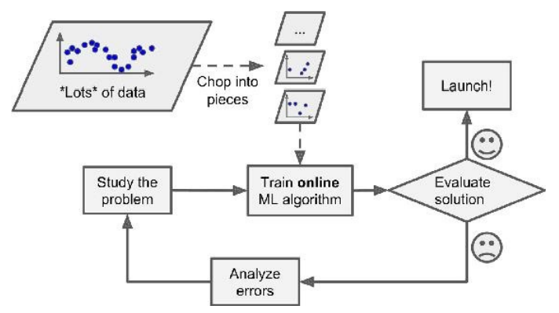
Types: Based on how training data is used
Batch learning: Uses all available data at a time during training
Mini Batch learning: Uses a subset of available at a time during training
Online (incremental) learning: a model is trained and launched into production, and then it keeps learning as new data comes in

Slide 46
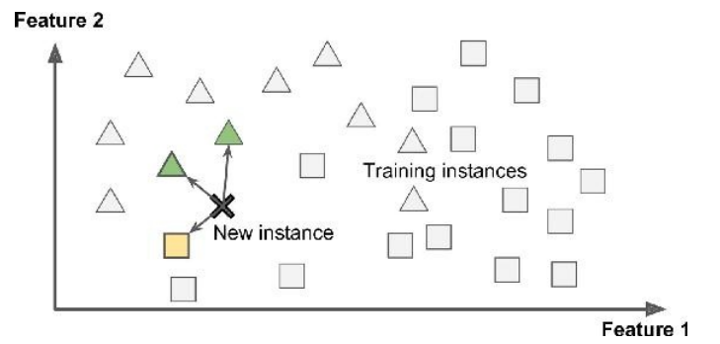
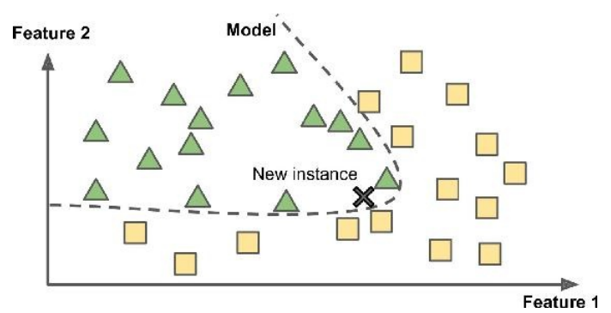
Types: Based on how training data is used
Instance Based Learning: Compare new data points to known data points
Model Based learning : Detect patterns in the training data and build a predictive model
Instance Based
Model Based

Slide 47
ML workflow

Slide 48
ML workflow
Should I use ML on this problem?
Is there a pattern to detect?
Can I solve it analytically?
Do I have data?
Gather and organize data.
Preprocessing, cleaning, visualizing.
Choosing a model, loss, regularization, ...
Optimization
Hyperparameter search
Analyze performance and mistakes, and iterate back to step 5 (or 3)

Slide 49
Example: Marks prediction
Data: survey, marks from previous years
Process the data
training set; test set
representation of input features; output
Choose form of model: linear regression
system’s performance evaluation: objective function
optimize performance by setting appropriate parameters: Optimization
Evaluate on test set: generalization

Slide 50
Few Terminologies
(To interpret the jargons in the prescribed text book)

Slide 51
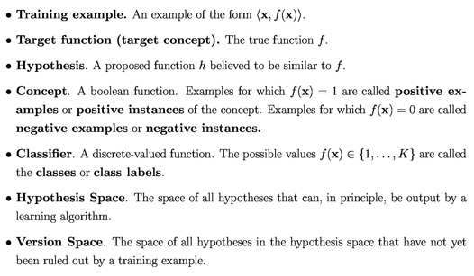
Amount taken | Period | Credit Score | Defaulter
40 lakhs | 5 years | 1000 | No
10 Lakhs | 5 months | 550 | YES
80 Lakhs | 3 years | 950 | No
20 Lakhs | 4 years | 1500 | No
Terminologies

Slide 52
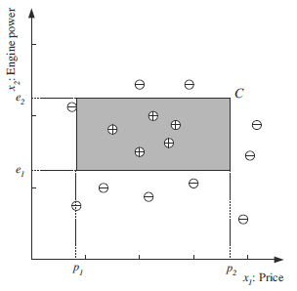
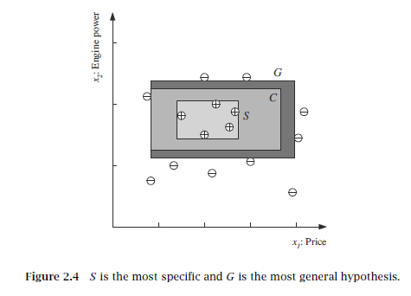
Hypothesis space
C=consistent hypothesis, S=specific hypothesis, G=Most general Hypothesis
Version space = Any h between S and G is a version space

Slide 53
Example : Credit card Processing by bank
Previous customer data: salary, years in residence, outstanding loans, did bank make money on that customer etc.
Input : X (customer data), Output : Y (yes/no decision)
Data set D of input-output examples: (x^{[1]}, y^{[1]}), (x^{[2]}, y^{[2]}), ..., (x^{[n]}, y^{[n]})
Target function f: X → Y (ideal formula for credit approval but unknown) → y^{[n]} = f(x^{[n]})
Learning algorithm that uses the data set D to pick a formula g
Hypothesis g: X → Y that approximates f.
Hypothesis set ( hypothesis space) : LA chooses g from a set of candidate formulas under consideration, which is called hypothesis set H. e.g. H could be the set of all linear formulas from which the algorithm would choose the best linear fit to the data
Generalization: When a new customer applies for credit, bank will base its decision on g (the hypothesis that the learning algorithm produced), not on f ( ideal target function which remains unknown).
Correctness of the decision depends on how good g faithfully replicates f

Slide 54
Inductive Learning Hypothesis
Any hypothesis found to approximate the target function well over a sufficiently large set of training examples will also approximate the target function well over other unobserved examples
Inductive learning or “Prediction”:
Given examples of a function (X, F(X))
Predict function F(X) for new examples X
Classification
F(X) = Discrete
Regression
F(X) = Continuous
Probability estimation
F(X) = Probability(X):

Slide 55
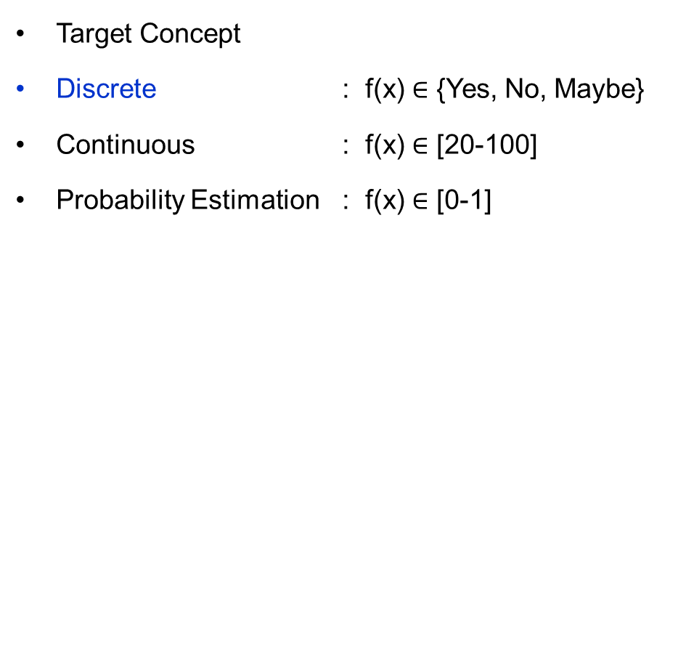
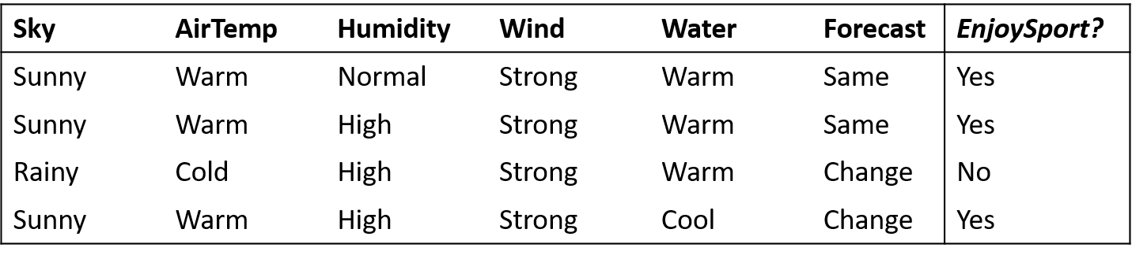
Inductive Learning Hypothesis
Classification
Regression

Slide 56
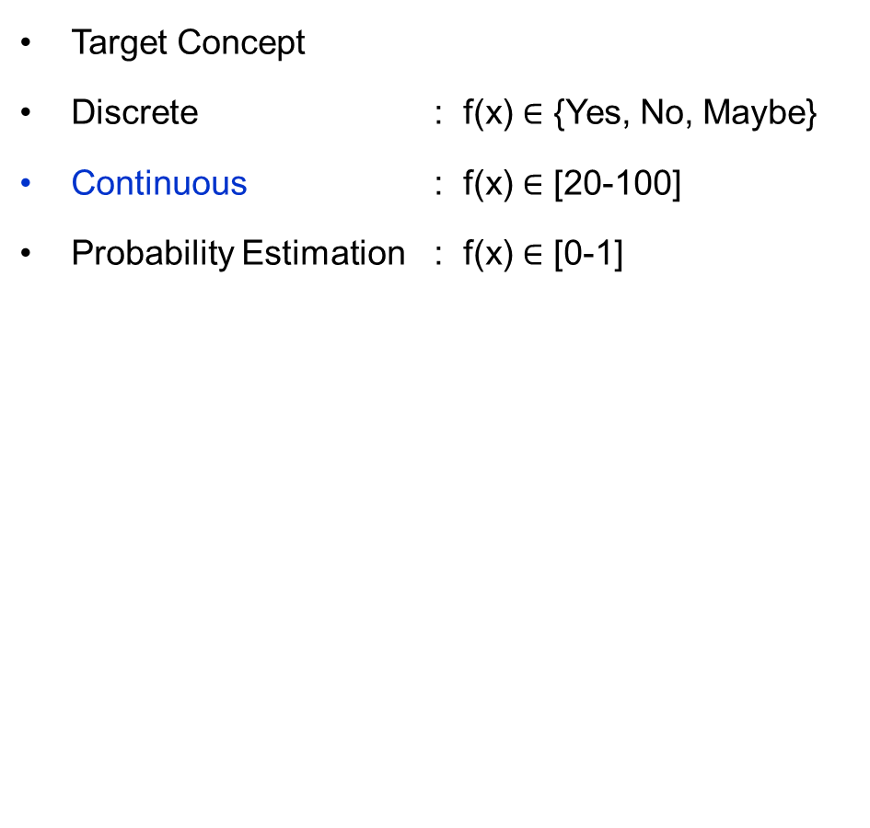
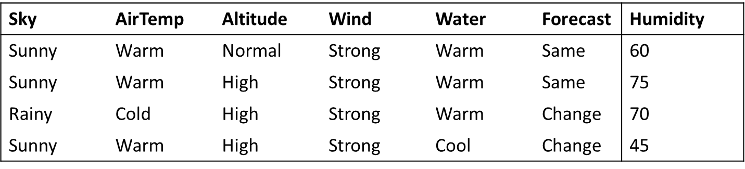
Inductive Learning Hypothesis
Classification
Regression

Slide 57
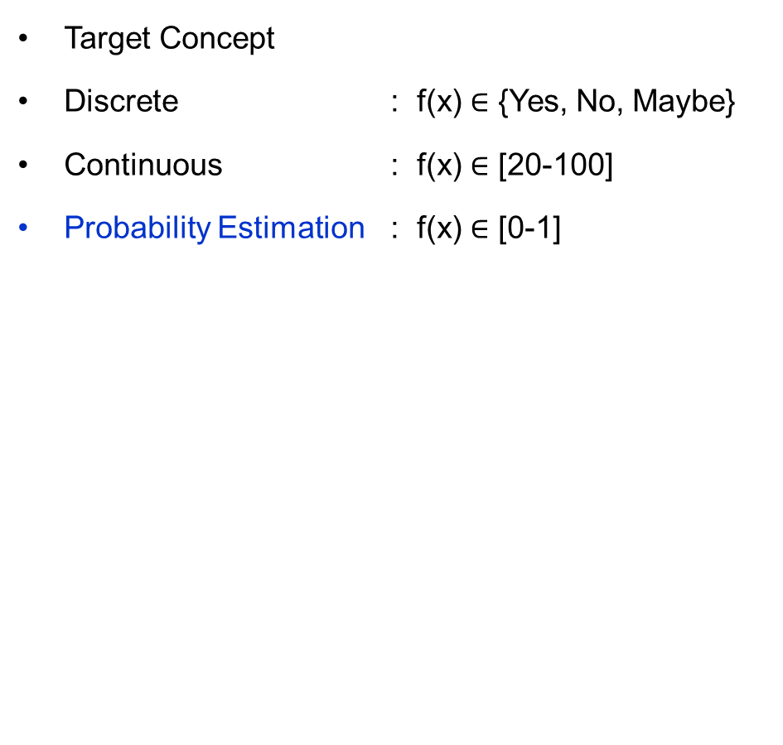
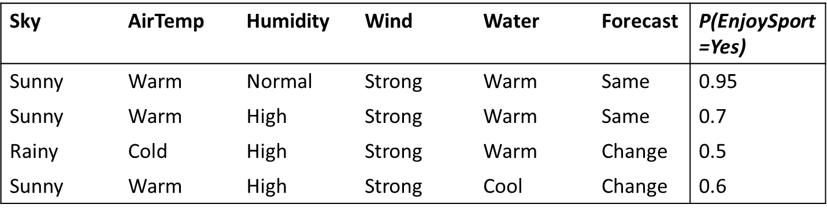
Inductive Learning Hypothesis
Classification
Regression

Slide 58
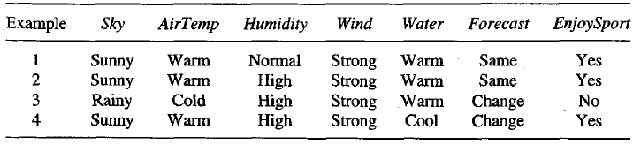
Hypothesis
One possible hypothesis (?, Cold, High, ?, ?, ?)
The most general hypothesis-that every day is a positive example-(?, ?, ?, ?, ?, ?)
The most specific possible hypothesis-that no day is a positive example (φ, φ, φ, φ, φ, φ)

Slide 59

References
Chapter 1,2 – Machine Learning, Tom Mitchell
Chapter 1, 2 – Introduction to Machine Learning, 2nd edition, Ethem Alpaydin
Chapter 1 - Pattern Recognition & Machine Learning Christopher M. Bhishop
http://www.cs.princeton.edu/courses/archive/spr08/cos511/ [Web]
https://www.softwaretestinghelp.com/machine-learning-tools/
BITS Pilani, Deemed to be University under Section 3 of UGC Act, 1956

Slide 60
Thank you !

